Slide 1

Cost Functions & Perfect Competition Tutorial & Lecture -18
Swagat Kishore Mishra

Slide 2
Types of Costs
Historical Vs Replacement Cost (Procurement stage Vs Replacing inventory stage)
Implicit cost Vs Explicit Cost (Opportunity cost Vs Out-of-pocket cost)
Incremental cost Vs Sunk cost (fixed with decision Vs varying with decision)

Slide 3
SR Relationship Between Production and Cost
A firm’s cost structure is intimately related to its production process.
Costs are determined by the production technology and input prices.
Assume the firm is a “price taker” in the input market.

Slide 4
SR Relationship Between Production and Cost
In order to illustrate the relationship, consider the production process described in the table.

Slide 5
SR Relationship Between Production and Cost
Total variable cost (TVC) is the cost associated with the variable input, in this case labor. Assume that labor can be hired at a price of w=$500 per unit. TVC has been added to the table.

Slide 6
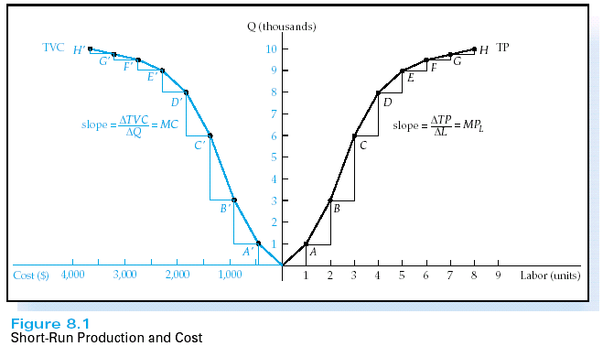
SR Relationship Between Production and Cost
Plotting TP and TVC illustrates that they are mirror images of each other.
When TP increases at an increasing rate, TVC increases at a decreasing rate.

Slide 7
SR Relationship Between Production and Cost
Total fixed cost (TFC) is the cost associated with the fixed inputs.
Total cost (TC) is the cost associated with all of the inputs. It is the sum of TVC and TFC.
TC=TFC+TVC

Slide 8
SR Relationship Between Production and Cost
Marginal cost (MC) is the change in total cost associated a change in output.
MC can also be expressed as the change in TVC associated with a change in output.

Slide 9
SR Relationship Between Production and Cost
Marginal Cost has been added to the table.
When MP is increasing, MC is decreasing.
When MP is decreasing, MC is increasing.

Slide 10
SR Relationship Between Production and Cost
The relationship between MP and MC can be seen mathematically in the following equations.
The law of diminishing returns
implies that MC will eventually
increase.

Slide 11
The Short Run Cost Function
A firm’s short run cost function tells us the minimum cost necessary to produce a particular output level.
For simplicity the following assumptions are made:
the firm employs two inputs, labor and capital
labor is variable, capital is fixed
the firm produces a single product
technology is fixed
the firm operates efficiently
the firm operates in competitive input markets
the law of diminishing returns holds

Slide 12
The Short Run Cost Function
The following average cost functions will be useful in our analysis.
Average total cost (AC) is the average per-unit cost of using all of the firm’s inputs.
Average variable cost (AVC) is the average per-unit cost of using the firm’s variable inputs.
Average fixed cost (AFC) is the average per-unit cost of using the firm’s fixed inputs.

Slide 13
The Short Run Cost Function
Mathematically,
AVC = TVC/Q
AFC = TFC/Q
ATC=TC/Q=(TFC+TVC)/Q=AFC+AVC

Slide 14
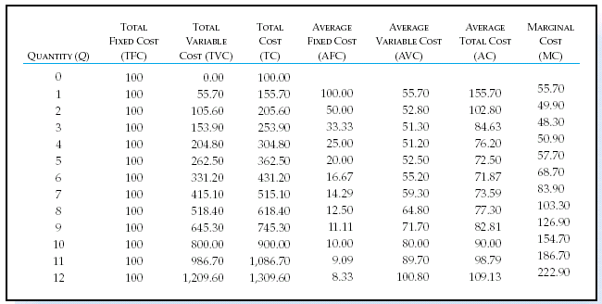
The Short Run Cost Function
Table 8.2 illustrates how the short run cost measures can be calculated.

Slide 15
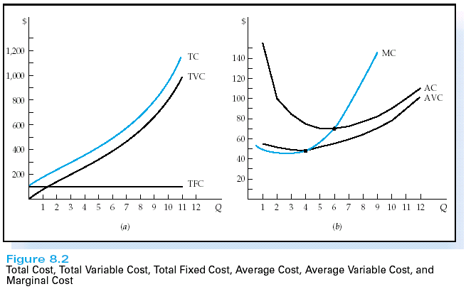
The Short Run Cost Function
Graphically, these results are be depicted in the figure below.

Slide 16
The Short Run Cost Function
Important Observations
AFC declines steadily over the range of production.
In general, AVC, AC, and MC are u-shaped.
MC measures the rate of change of TC
When MC<AVC, AVC is falling
When MC>AVC, AVC is rising
When MC=AVC, AVC is at its minimum
The distance between AC and AVC represents AFC

Slide 17
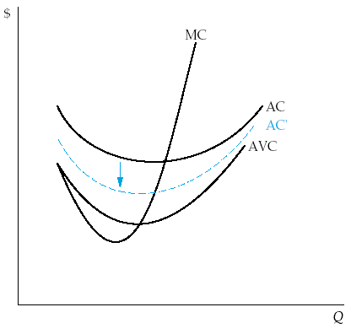
The Short Run Cost Function
A change in input prices will act to shift the cost curves.
If there is a reduction in the costs associated with the fixed inputs, the average total cost will shift downward. AVC and MC will remain unaffected.

Slide 18
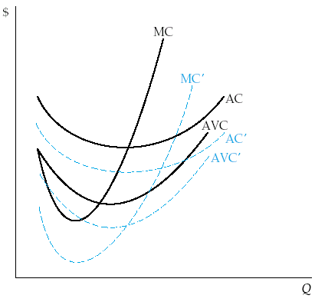
The Short Run Cost Function
If there is a reduction in the costs associated with the variable inputs, then the MC, AVC, and AC will all shift downward.

Slide 19
The LR Relationship Between Production and Cost
In the long run, all inputs are variable.
In the long run, there are no fixed costs
The long run cost structure of a firm is related to the firm’s long run production process.
The firm’s long run production process is described by the concept of returns to scale.

Slide 20
The LR Relationship Between Production and Cost
Economists hypothesize that a firm’s long-run production function may exhibit at first increasing returns, then constant returns, and finally decreasing returns to scale.
When a firm experiences increasing returns to scale
A proportional increase in all inputs increases output by a greater percentage than costs.
Costs increase at a decreasing rate

Slide 21
The LR Relationship Between Production and Cost
When a firm experiences constant returns to scale
A proportional increase in all inputs increases output by the same percentage as costs.
Costs increase at a constant rate
When a firm experiences decreasing returns to scale
A proportional increase in all inputs increases output by a smaller percentage than costs.
Costs increase at an increasing rate

Slide 22
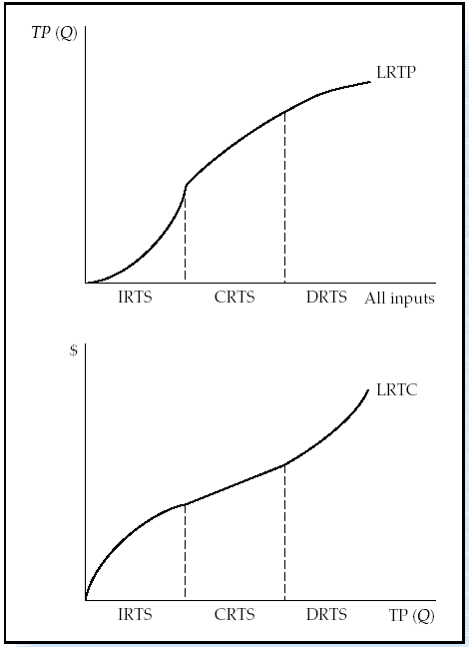
The LR Relationship Between Production and Cost
This graph illustrates the relationship between the long-run production function and the long-run cost function.

Slide 23
The Long-Run Cost Function
Long run marginal cost (LRMC) measures the change in long run costs associated with a change in output.
Long run average cost (LRAC) measures the average per-unit cost of production when all inputs are variable.
In general, the LRAC is u-shaped.

Slide 24
The Long-Run Cost Function
When LRAC is declining we say that the firm is experiencing economies of scale.
Economies of scale implies that per-unit costs are falling.
When LRAC is increasing we say that the firm is experiencing diseconomies of scale.
Diseconomies of scale implies that per-unit costs are rising.

Slide 25
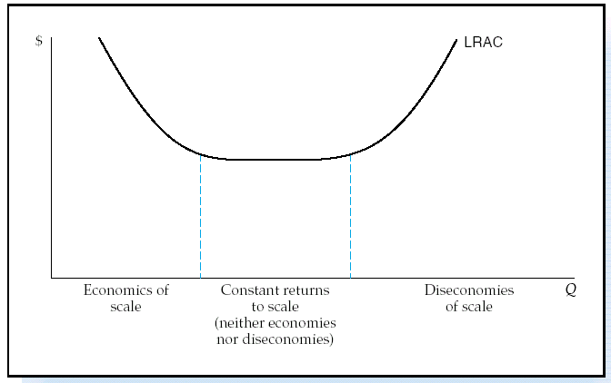
The Long-Run Cost Function
The figure illustrates the general shape of the LRAC.

Slide 26
The Long-Run Cost Function
Reasons for Economies of Scale
Increasing returns to scale
Specialization in the use of labor and capital
Indivisible nature of many types of capital equipment
Productive capacity of capital equipment rises faster than purchase price

Slide 27
The Long-Run Cost Function
Reasons for Economies of Scale
Economies in maintaining inventory of
replacement parts and maintenance personnel
Discounts from bulk purchases
Lower cost of raising capital funds
Spreading promotional and R&D costs
Management efficiencies

Slide 28
The Long-Run Cost Function
Reasons for Diseconomies of Scale
Decreasing returns to scale
Disproportionate rise in transportation costs
Input market imperfections
Management coordination and control
problems
Disproportionate rise in staff and indirect
labor

Slide 29
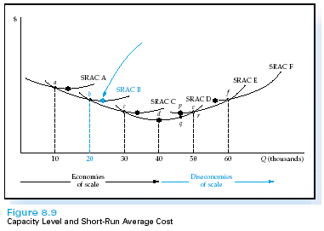
The Long-Run Cost Function
In the short run, the firm has a fixed level of capital equipment or plant size.
The figure illustrates the SRAC curves for various plant sizes.
Once a plant size is chosen, per-unit production costs are found by moving along that particular SRAC curve.

Slide 30
The Long-Run Cost Function
In the long run the firm is able to adjust its plant size.
LRAC tells us the lowest possible per-unit cost when all inputs are variable.
What is the LRAC in the graph?

Slide 31
The Long-Run Cost Function
The LRAC is the lower envelope of all of the SRAC curves.
Minimum efficient scale is the lowest output level for which LRAC is minimized.

Slide 32
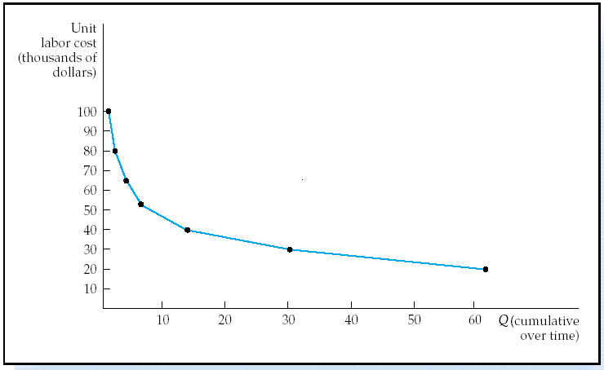
The Learning Curve
Measures the percentage decrease in additional labor cost each time output doubles.
An “80 percent” learning curve implies that each time output doubles, the labor costs associated with the incremental output will decrease to 80% of their previous level.
The figure illustrates an 80-percent learning curve.

Slide 33
The Learning Curve
A downward slope in the learning curve indicates the presence of the learning curve effect.
workers improve their productivity with practice
The learning curve effect acts to shift the SRAC downward.

Slide 34
Economies of Scope
The reduction of a firm’s unit cost by producing two or more goods or services jointly rather than separately.

Slide 35
Other Methods to Reduce Costs
The Strategic Use of Cost
Reduction in the Cost of Materials
Using IT to Reduce Costs
Reduction of Process Costs
Relocation to Lower-Wage Countries or Regions
Mergers, Consolidation, and Downsizing
Layoffs and Plant Closings

Slide 36
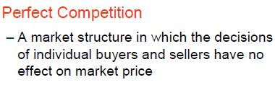
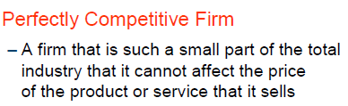

PERFECT COMPETITION

Slide 37
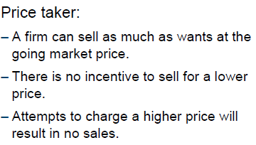
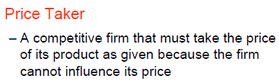
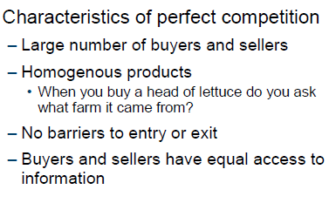
ASPECTS

Slide 38

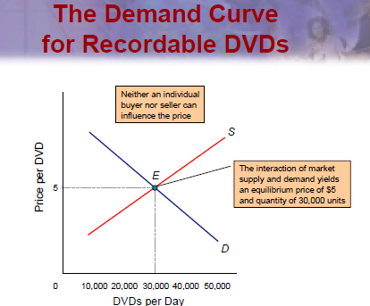
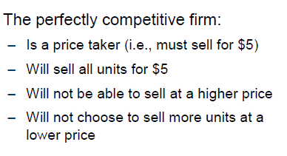

Slide 39
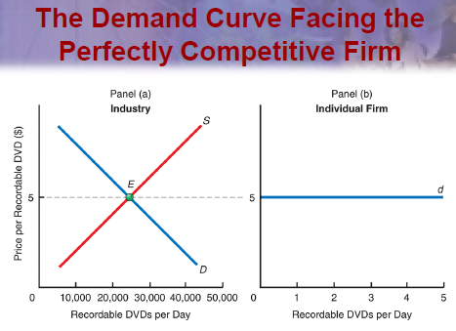
DEMAND

Slide 40
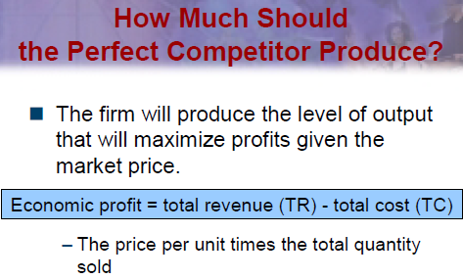
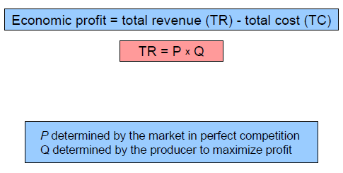
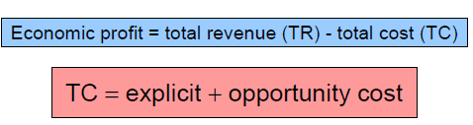

Slide 41
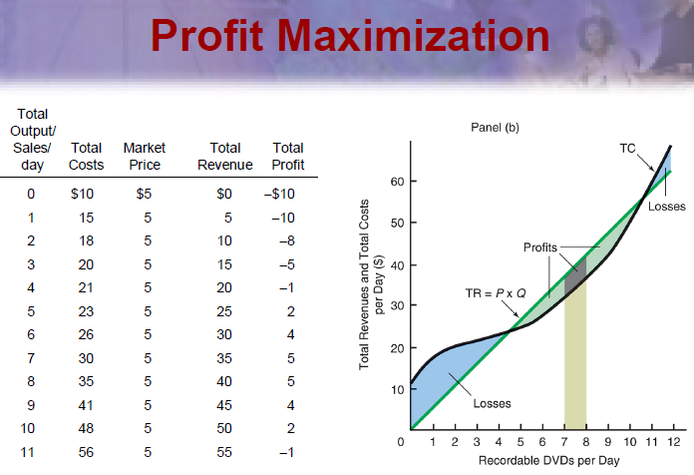

Slide 42
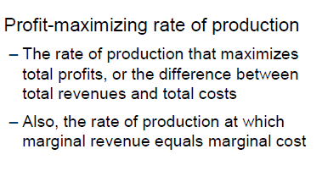
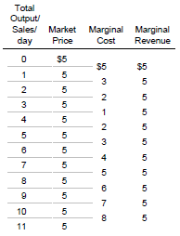
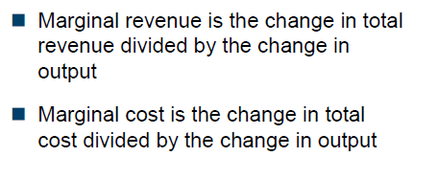
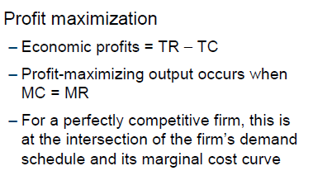

Slide 43

thank You

